Slide 1


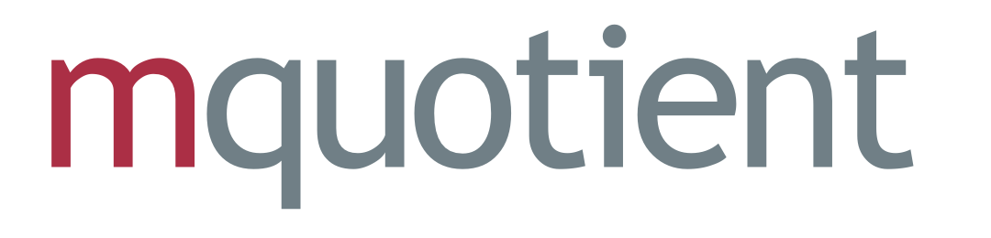




business services
professional services to drive exceptional value and measurable outcomes.
Discover & Consult
Our consultants seamlessly integrate into your process discovery initiatives, helping clients identify business objectives and develop tailored solutions with Microsoft AI and UiPath tools.
OnDemand Services
Offer your clients rapid deployment of AI and automation solutions without the overhead of maintaining in-house experts
Managed Services
From managing and optimizing implementations to maintaining automation workflows, we ensure seamless operations for clients, enhancing their satisfaction and driving long-term engagement.
Notes:
Presales Activities for UiPath and Microsoft Dynamics Services
Tailored Solutions and Demonstrations: Conduct discovery sessions to understand client-specific needs, design tailored solutions or Proofs of Concept (PoCs), and showcase how UiPath or Dynamics 365 addresses pain points with automation and system optimization.
ROI-Driven Business Cases: Build compelling business cases highlighting cost savings, efficiency improvements, and measurable ROI to demonstrate the value of automation or ERP/CRM solutions.
Seamless Integration and Roadmap Planning: Provide detailed integration strategies with existing systems and propose phased implementation roadmaps, ensuring scalability and smooth adoption through training and support

Slide 2
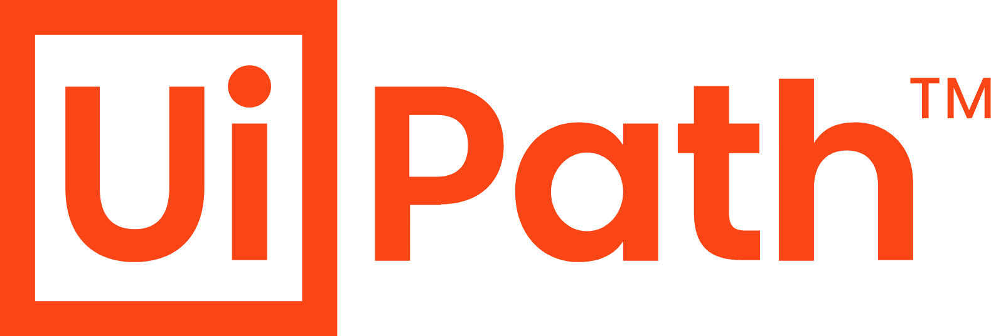




Key Offerings
Innovate. Integrate. Elevate.
Strategic Business Growth
Presales and Marketing Enablement
Intelligent Automation Solutions using
Robotic Process Automation (RPA)
Advanced Analytics & AI Consulting
Data & AI Professional Services
Presales Support - Technical expertise & solution design assistance to drive client acquisition and retention.
Tailored Marketing Enablement: Impactful Demos
Business Strategy Alignment: Craft customized strategies that align with your clients' business goals and drive long-term growth.
Process Discovery & Optimization: Identify automation opportunities and streamline workflows Scalable RPA Implementation: Deploy efficient, scalable automation solutions tailored to diverse industries Ongoing RPA Management: Offer monitoring, optimization, and enhancements to ensure continuous value from automation initiatives.
Custom AI Solutions: Design and deploy applications using AI tools for vision, speech, language, & generative AI.
Data Analytics Enablement: Advanced analytics & predictive modeling Comprehensive Managed Services: Provide ongoing support for AI and analytics deployments, ensuring performance, reliability, and scalability.
Notes:
Key Offerings
1. Strategic Business Growth
Presales Support: Equip your team with technical expertise and solution design assistance to drive client acquisition and retention.
Tailored Marketing Enablement: Provide impactful content, case studies, and demos to position your RPA and AI solutions effectively.
Business Strategy Alignment: Collaborate to craft customized strategies that align with your clients' business goals and drive long-term growth.
2. Intelligent Automation Solutions Using Robotic Process Automation (RPA)
Process Discovery & Optimization: Identify automation opportunities and streamline workflows with tools like UiPath and other RPA platforms.
Scalable RPA Implementation: Deploy efficient, scalable automation solutions tailored to diverse business processes and industry needs.
Ongoing RPA Management: Offer monitoring, optimization, and enhancements to ensure continuous value from automation initiatives.
3. Advanced Analytics & AI Consulting
Custom AI Solutions: Design and deploy AI-driven applications using Microsoft AI tools for vision, speech, language, and generative AI.
Data Analytics Enablement: Unlock actionable insights from data through advanced analytics and predictive modeling techniques.
Comprehensive Managed Services: Provide ongoing support for AI and analytics deployments, ensuring performance, reliability, and scalability.

Slide 3

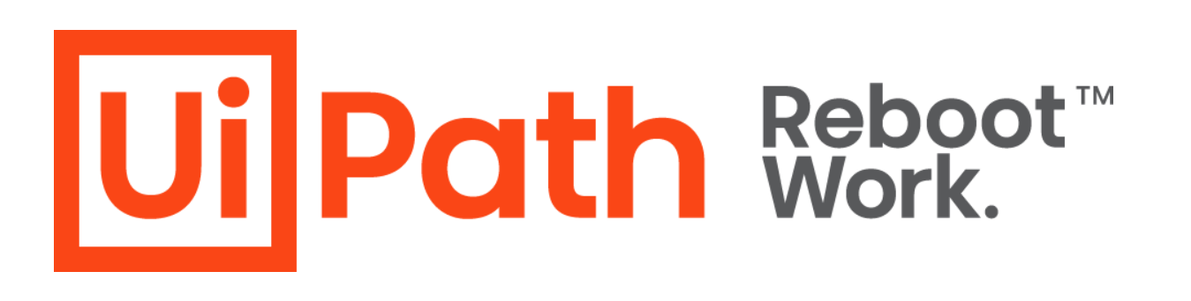
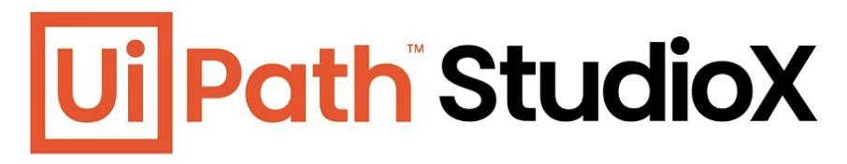


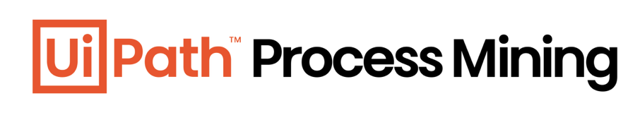


Professional Services
Consultancy
Process Diagnostic
Software Development
Maintenance-as-a-Service
adfsgfdhgjdhkfjlgk;h’lj;glhfkgdjfshdagsfaDGAFHDSGJDH,FHJFSHDGSFDA
WRITE HERE
WRITE HERE
Relationship Management
Design Program Roadmap
Process Expertise
Develop overall Solution
Core development team
Build digital solutions
Monitors / fixes issues
Notes:
Professional services for **UiPath implementations** involve a suite of offerings designed to help organizations effectively deploy, customize, and scale **Robotic Process Automation (RPA)** solutions. These services typically encompass the full lifecycle of automation projects, from initial assessment and strategy to implementation, training, and ongoing support. Here's what these services often include:
---
### **1. Strategy and Assessment**
- **RPA Readiness Assessment:**
Evaluating the organization's processes to identify automation opportunities and determine readiness for RPA adoption.
- **Automation Roadmap:**
Developing a strategic plan that aligns with business goals, prioritizes processes for automation, and outlines timelines.
- **ROI Analysis:**
Assessing the cost-benefit and potential return on investment of UiPath implementations.
---
### **2. Process Identification and Design**
- **Process Discovery:**
Using tools like UiPath Task Capture or Automation Hub to document and analyze processes suitable for automation.
- **Process Mapping and Reengineering:**
Designing workflows that optimize existing processes for automation.
- **Business Case Development:**
Creating detailed cases to justify automation initiatives, including cost savings, efficiency gains, and compliance improvements.
---
### **3. UiPath Implementation and Development**
- **RPA Solution Development:**
Building automation workflows using UiPath Studio or StudioX tailored to specific business needs.
- **Integration Services:**
Connecting UiPath robots with third-party applications, databases, APIs, and legacy systems.
- **Orchestration:**
Deploying and managing robots using UiPath Orchestrator for centralized control, monitoring, and scheduling.
- **Testing and Validation:**
Conducting rigorous testing to ensure robots perform as expected, including user acceptance testing (UAT).
---
### **4. Deployment and Scaling**
- **Pilot Deployment:**
Rolling out initial automations to test feasibility and effectiveness in a controlled environment.
- **Enterprise Rollout:**
Scaling RPA solutions across departments, geographies, or the entire organization.
- **Hybrid Implementations:**
Combining attended and unattended automation to maximize flexibility and efficiency.
---
### **5. Training and Change Management**
- **Employee Training:**
Educating employees on using UiPath tools, including Studio, Orchestrator, and Assistant.
- **Citizen Developer Enablement:**
Empowering non-technical users to create simple automations with tools like UiPath StudioX.
- **Change Management:**
Supporting organizational change to ensure acceptance and seamless integration of automation into workflows.
---
### **6. Governance and Compliance**
- **RPA Governance Framework:**
Establishing guidelines for robot development, deployment, and monitoring to ensure consistency and scalability.
- **Security and Compliance:**
Implementing measures to protect sensitive data and comply with industry regulations like GDPR, HIPAA, or SOX.
---
### **7. Support and Maintenance**
- **Ongoing Monitoring:**
Proactively monitoring robot performance and ensuring uptime.
- **Incident Management:**
Addressing any issues or failures in automated workflows.
- **Enhancements and Updates:**
Regularly improving automations based on user feedback and business needs.
---
### **8. Advanced Capabilities**
- **AI Integration:**
Incorporating UiPath AI Center or Document Understanding to enable intelligent automation, such as natural language processing or image recognition.
- **Process Mining:**
Using UiPath Process Mining to identify inefficiencies and further automation opportunities.
- **Analytics and Insights:**
Leveraging UiPath Insights for advanced analytics on RPA performance and business impact.
---
### **Typical Deliverables**
1. **Automation Strategy Document:**
Outlines the approach, processes, and goals for RPA implementation.
2. **Developed Workflows:**
Ready-to-deploy automated workflows.
3. **Governance Framework:**
Documentation for standards, security, and best practices.
4. **Training Materials:**
Guides and modules for end-users and developers.
5. **Performance Reports:**
Metrics and KPIs demonstrating automation success and areas for improvement.
---
### **Why Engage Professional Services?**
Professional UiPath implementation services ensure:
- Efficient use of UiPath’s tools and capabilities.
- Faster time-to-value with automation.
- Reduction in risks associated with RPA deployment.
- A sustainable and scalable RPA program aligned with business needs.
Would you like suggestions on vendors or additional insights into pricing and timelines for these services?

Slide 4
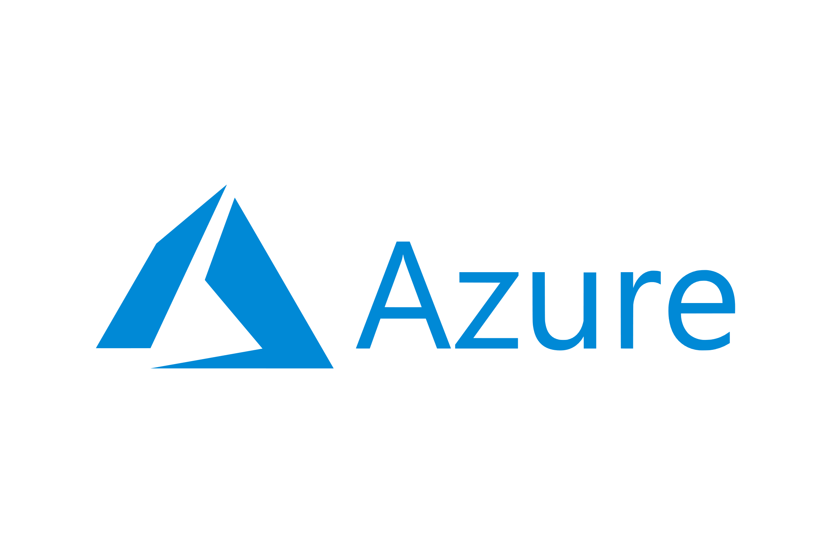

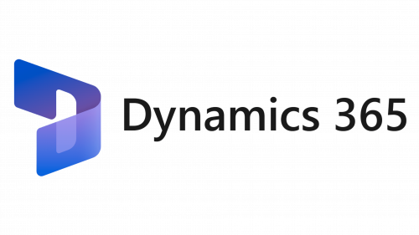

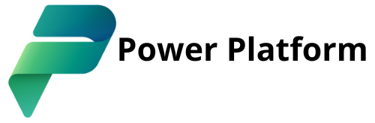
Professional Services
Cloud Services
AI & Machine Learning
Unlock the full potential of Microsoft Cloud Services
Empowering Businesses to harness AI/ML using Azure AI, OpenAI, & Copilot
Cloud Strategy & Assessment
Migration Services
Cost Optimization
Managed Services
Custom AI Models
Generative AI Applications
Integration & Deployment
Data Preparation & Training
Implementation
Customization
Integration
Training & Support
Microsoft 365 AI Integration
Workflow Automation
User Training
App Development
Process Automation
Data Analysis
AI Builder
Collaboration
Notes:
Microsoft Cloud Services Offered
Azure
Cloud Strategy & Assessment: Evaluate your client's current infrastructure to recommend optimal Azure solutions.
Migration Services: Seamless migration of applications, data, and workloads to Azure with minimal downtime.
Cost Optimization: Continuous monitoring and optimization to reduce costs and improve resource utilization.
Managed Services: End-to-end cloud management, monitoring, and security compliance.
Microsoft Dynamics
Implementation: Configure Dynamics 365 to align with your client's business processes.
Customization: Develop custom modules, workflows, and dashboards tailored to specific needs.
Integration: Connect Dynamics with ERP, CRM, and third-party tools to ensure a unified system.
Training & Support: Empower teams to maximize productivity with hands-on training and ongoing support.
Power Platform
App Development: Leverage Power Apps to create low-code custom applications tailored to business needs.
Process Automation: Use Power Automate to streamline workflows, reduce manual intervention, and improve efficiency.
Data Analysis: Integrate with Power BI for detailed reporting and insights.
AI Builder: Enable AI-driven capabilities to automate complex processes and gain predictive insights.
Collaboration: Enhance teamwork with Power Virtual Agents for creating intelligent chatbots and automating customer interactions.
Artificial Intelligence and Machine Learning Services Offered
AI Strategy & Consulting
AI Readiness Assessment: Evaluate your client’s current capabilities and readiness for AI integration.
Use Case Identification: Identify impactful business use cases for AI and ML adoption tailored to the client’s goals.
Azure AI & OpenAI Services
Custom AI Models: Develop AI solutions for vision, speech, and language processing, leveraging Azure AI and OpenAI models like GPT and DALL·E.
Generative AI Applications: Implement generative AI to streamline tasks such as content creation, summarization, and ideation.
Integration & Deployment: Seamlessly integrate AI into existing applications and workflows.
Data Preparation & Training: Clean, organize, and prepare data for effective AI model training.
Copilot Integration
Microsoft 365 AI Integration: Deploy and customize Copilot to enhance productivity in apps like Word, Excel, PowerPoint, and Teams.
Workflow Automation: Automate repetitive tasks, generate insights, and drive collaboration with Copilot capabilities.
User Training: Train employees to maximize their productivity with AI-powered tools.
Ongoing Support & Optimization
Performance Monitoring: Continuously monitor AI tools for optimal performance and scalability.
Feature Updates: Keep AI models and integrations up-to-date with the latest advancements in Microsoft AI.

Slide 5
APPENDIX

Slide 6
Professional Services
Innovate. Integrate. Elevate.
Dynamics 365 – Business Central
Business Central Base
Accounting Add-ons
Inventory Add-ons
Advanced Inventory Management
Basic Accounting
Single Company Setup / General Ledger
Bank Reconciliation
General, Recurring & Reversing Journal Entries
General Ledger Budgets
Standard Tax
Multi-Currency
Standard BS and IS Reporting
Dimension (financial tags) Reporting
Approvals
Purchasing
Vendor Management
Purchase Quotes / Orders / Credits / Ledger
Vendor Payment Management (ACH or Check)
Purchase Prices / Discounts
Deferrals / Prepayments
Sales
Customer Management
Sales Quotes / Orders / Credits / Ledger
Cash Receipts
Sales Prices / Discounts
Deferrals / Prepayments
Customer Statements
Project Accounting
Project Costing
Job/Task Budgets
Job Invoicing & Batch Billing
Cost allocation from Purchase Document
Timesheets
Advanced Inventory
Multiple UOMs / Locations / Bins
Drop Shipments
Serial and Lot Number Tracking
Variants
Inventory Reservations
Transfer Orders
Assembly
Assembly BOMs
Assemble to Order
Assemble to Stock
Auto Assemble on Shipment
Warehousing
Inventory Picks and Put-aways
Multiple Order Processing (Shipments/Receipt)
Compatible with 3rd party WMS Solutions
Basic Accounting
Finance and Inventory Integration
On-Hand Inventory Visibility
Item Specific Pricing & Discounts
Item Categories & Attributes
Costing Methods (FIFO, Average, Specific)
Advanced Project Accounting
WIP Calculations
WIP Dashboard
Cost/Revenue Recognition
Integrated with G/L
Planning
Item SKUs by Location
Planning Parameters
Supply suggestions based on demand
Bulk create supply orders
Fixed Assets
FA Management
Calculated Depreciation
Linked to G/L, S/L, P/L
Multi-Company
Multiple Company Setup (up to 5 companies)
Intercompany sending/receiving journals
Intercompany Sales & Purchase Documents
Consolidation
ALL PACKS INCLUDE THE FOLLOWING FEATURES
Tenant set-up | Pack configuration | Master Data Imports | Remote training | Opening Balance Imports

